Slide 1

Primitives: KEM-DEM Security Pen & Paper Proof
https://prooffrog.github.io/caps-2025.html
Douglas Stebila
We acknowledge the support of the Natural Sciences and Engineering Research Council of Canada (NSERC).

Slide 2
Recap: Provable Security and Game Hopping Proofs

Slide 3
Recap of provable security
Main approach of reductionist security:
Define the syntax of the relevant primitives
Define security experiments for the relevant primitives
Specify your scheme
State a theorem bounding the success probability for a certain class of adversaries in breaking security of your scheme
usually depending on the success probability of breaking security of underlying primitives (and other terms)
Prove the theorem

Slide 4
Code-based game-playing proofs
Papers
Shoup 2004
Bellare & Rogaway 2004
…
Textbooks
Katz & Lindell, Introduction to Modern Cryptography
Rosulek, Joy of Cryptography
…

Slide 5
Code-based game-playing proofs
A security definition is an experiment (expressed in pseudocode) with oracles

Slide 6
Different ways of structuring the experiment & oracles
main function that explicitly calls adversary with specified oracles
initialize / adversary access to all oracles / finalize
initialize / adversary access to all oracles + direct adversary output

Slide 7
Different experiment styles
single-game win/lose (secure if success probability ≈ 0)
single-game hidden bit guessing (secure if success probability ≈ ½)
two-game indistinguishability: left/right, real/random, real/ideal, ... (secure if distinguishing advantage ≈ ½)
Can even do this style for traditional win/lose games like unforgeability: e.g. "check" oracle that runs verify (real) versus rejects if not on a list (ideal)

Slide 8
Terminology
A library is a collection of algorithms (each with input/output interfaces) and private variables that the algorithms can access.
An algorithm can call into a library. The combined program is denoted
Notes:
\mathcal{A} \diamond \mathcal{L}

Slide 9
Libraries for security definitions
We will use libraries to formalize a security definition:
private variables for the experiment
initialize routine
oracles that the adversary can call
For a scheme in a two-game indistinguishability experiment we want to show that, for all programs
Notes:
\Pr[ \mathcal{A} \diamond \mathcal{L}_{left}^\Sigma \Rightarrow \mathsf{true} ] \approx \Pr[ \mathcal{A} \diamond \mathcal{L}_{right}^\Sigma \Rightarrow \mathsf{true} ]

Slide 10
Terminology
Inlining library into program (or library) : inserting the code from library into another program in every place where a subroutine of library is called
Interchangeable: libraries and are interchangeable (denoted ) if, for all programs it holds that
Interchangeability comes up in "rewriting steps" in game-hopping proofs.)
One way of showing interchangeability is to show that and is to show that they are "code-wise equivalent", meaning they have the same source code, or "equivalent" source code
Indistinguishability: libraries and are indistinguishable if, for all programs it holds that
Notes:
\Pr[ \mathcal{A} \diamond \mathcal{L}_1 \Rightarrow \mathsf{true} ] = \Pr[ \mathcal{A} \diamond \mathcal{L}_2 \Rightarrow \mathsf{true} ]

Slide 11
Game-hopping proofs
Goal: Show
Game 0 = is the inlining of the code for your scheme into security experiment
Game 1 is another game (library) typically formed by changing some lines of Game 0
Game 1 and Game 0 could be indistinguishable for one of several reasons:
They are in fact interchangeable (code-wise equivalent)
They are indistinguishable under some computational assumption
They are indistinguishable under some statistical argument

Slide 12
Game-hopping proofs
Suppose we want to show Game 0 and Game 1 are indistinguishable under some computational assumption.
Namely suppose scheme satisfies a two-game security notion
We define a reduction that is an adversary to such that
We can conclude that Game 0 and Game 1 are indistinguishable assuming is secure

Slide 13
Game-hopping proofs
Goal: Show
Repeat game hops as many times as needed until we arrive at a Game n such that
To summarize, a proof consists of
Specifying each intermediate game (some can technically be omitted if they are implied by the reductions)
Justifying each game hop
If using indistinguishability:
Specifying the reduction for each hop
Justifying that each reduction inlined to its left/right game is code-wise equivalent to the previous/next game

Slide 14
KEM-DEM is IND-CPA
in the Joy of Cryptography style with figures by Mike Rosulek https://garbledcircus.com/kemdem/left-right

Slide 15
Goal: KEM-DEM is IND-CPA
Construction: Build a public key encryption scheme by
using a key encapsulation mechanism to compute a shared secret,
and use that shared secret in a symmetric encryption scheme (data encapsulation mechanism) to encrypt a message.
Security: Show that the KEM-DEM approach yields an IND-CPA-secure public key encryption scheme assuming that
the KEM is IND-CPA-secure
and the symmetric encryption scheme has one-time secrecy

Slide 16
Goal: KEM-DEM is IND-CPA
Idea of the proof:
Game 0 = Starting game: Encrypt left message under real key
Game 1: Use random KEM shared secret instead of real
Game 2: Encrypt right message instead of left (under random key)
Game 3: Use real KEM shared secret instead of random
Game 3 = Ending game: Encrypt right message under real key

Slide 17
If we want to be thorough, we need to:
Symmetric encryption scheme: define (a) syntax; (b) one-time secrecy
Key encapsulation mechanism: define (a) syntax; (b) IND-CPA security
Public key encryption scheme: define (a) syntax; (b) IND-CPA security
State the KEM-DEM scheme
Give a game-hopping proof for IND-CPA security of KEM-DEM
State intermediate games (can be implicit)
Give reductions to security of KEM or DEM
Justify interchangeability / indistinguishability
State the theorem we just proved

Slide 18
Opinionated choices for this proof
In the style of Joy of Cryptography by Mike Rosulek
All security experiments are two-game indistinguishability: left/right, real/random
All security experiments structured with initialize / adversary access to all oracles + direct adversary output
Adversary gets setup values via oracles rather than direct input

Slide 19
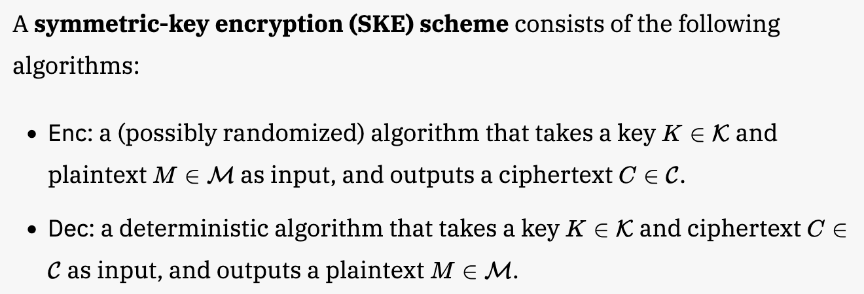
1.a) Syntax of symmetric encryption scheme

Slide 20
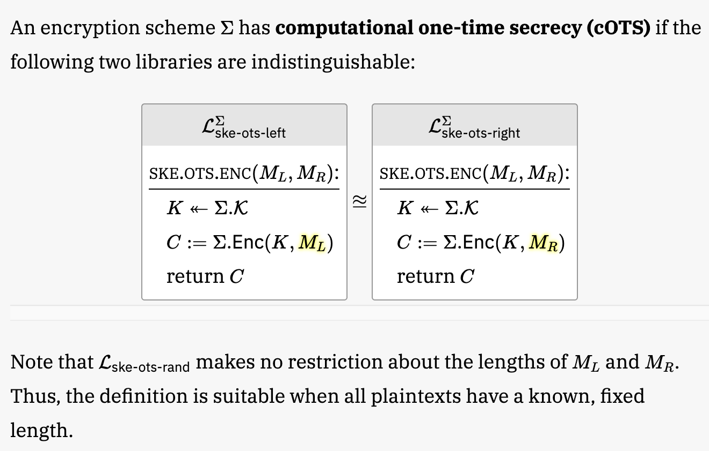
1.b) One-time secrecy of symmetric encryption

Slide 21
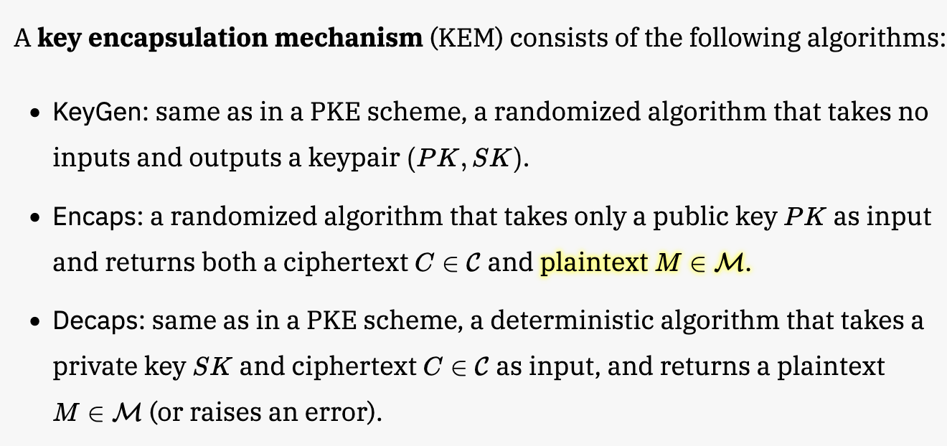
2.a) Syntax of key encapsulation mechanism

Slide 22
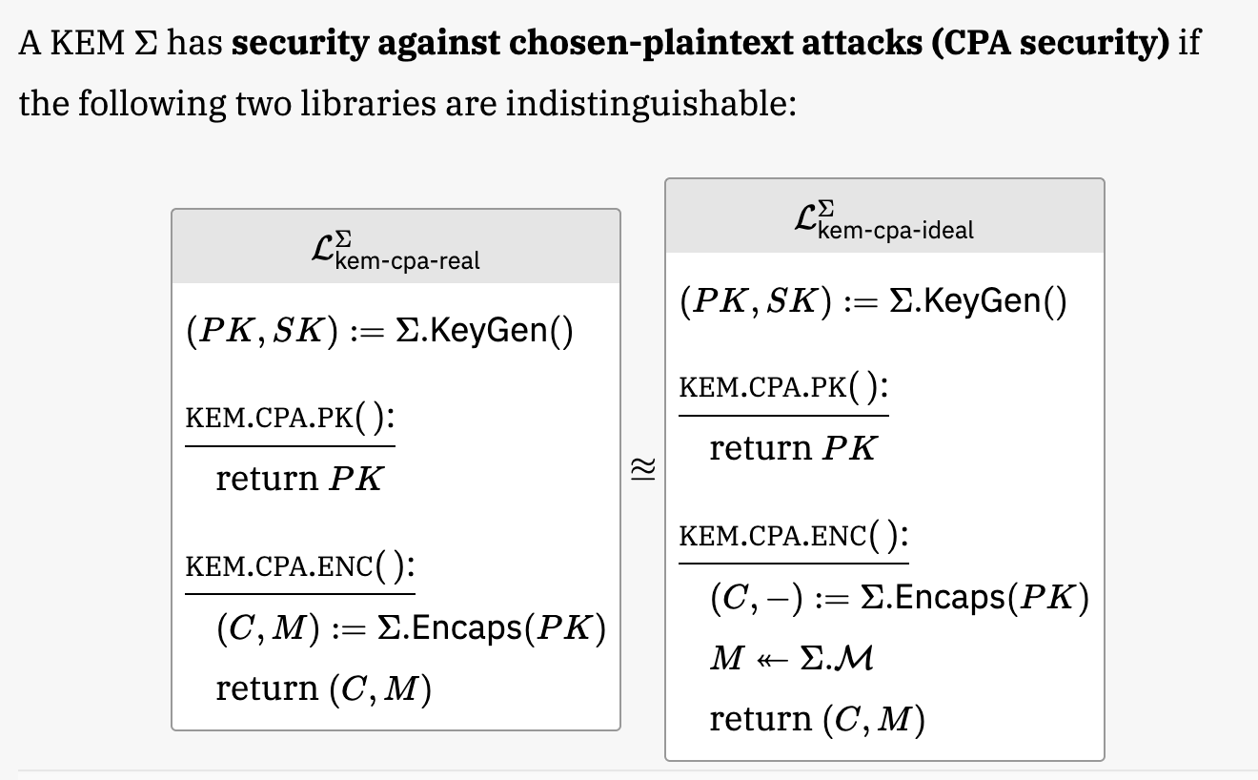
2.b) IND-CPA security of a KEM
Initialize
Experiment
private
variables
Adversary gets public key via oracle

Slide 23
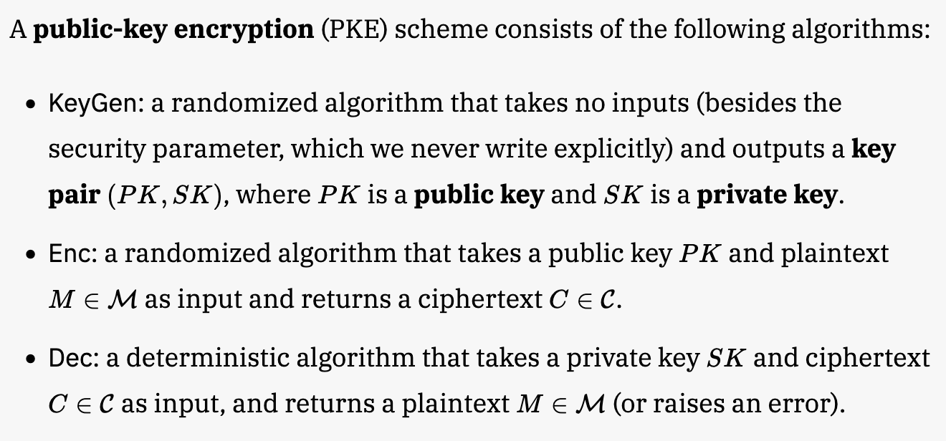
3.a) Syntax of public key encryption

Slide 24
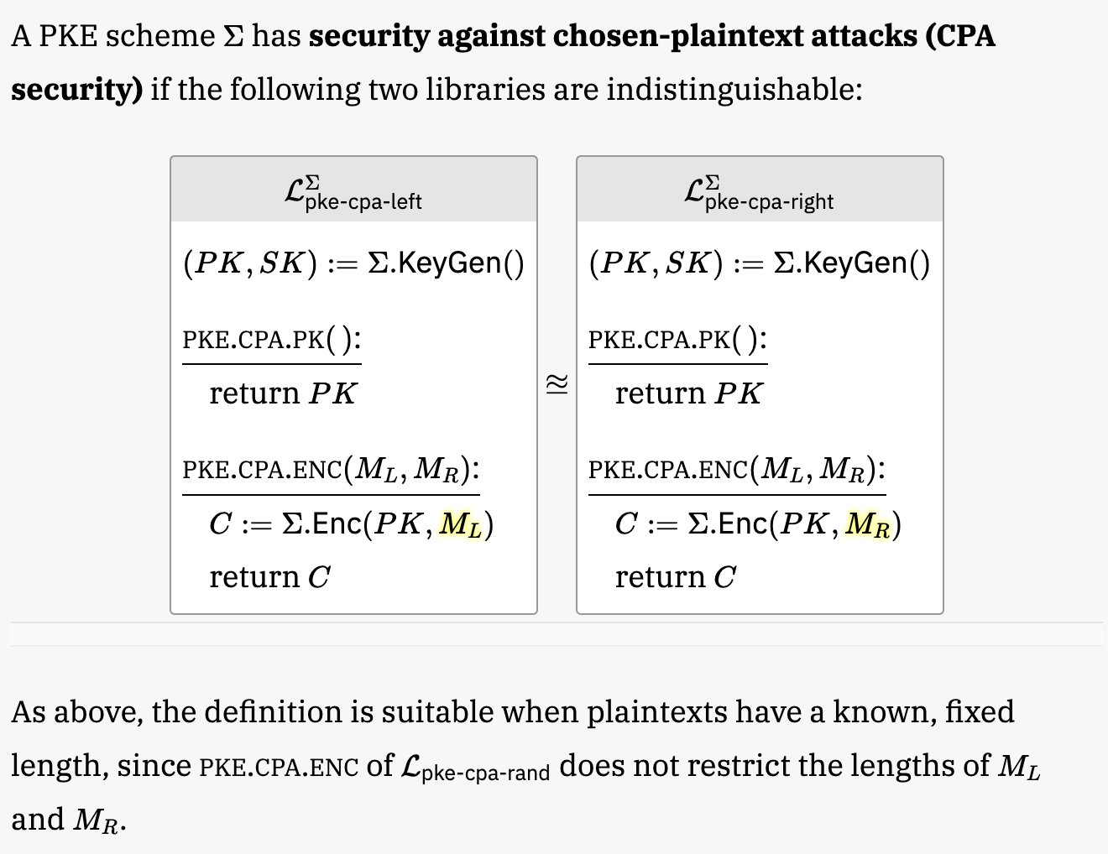
3.b) IND-CPA security of a PKE

Slide 25
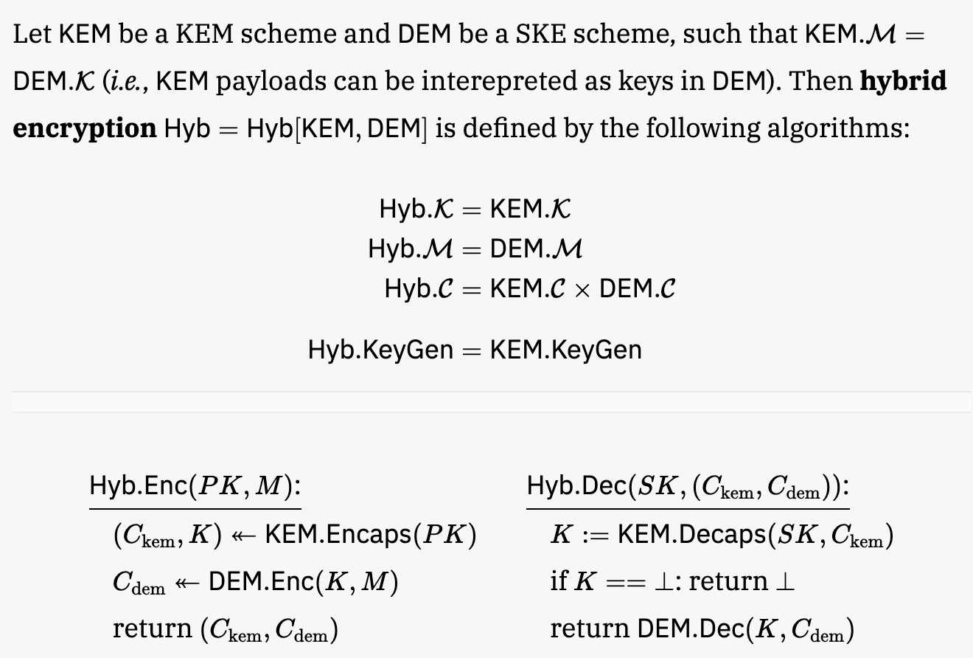
4. State the KEM-DEM scheme

Slide 26
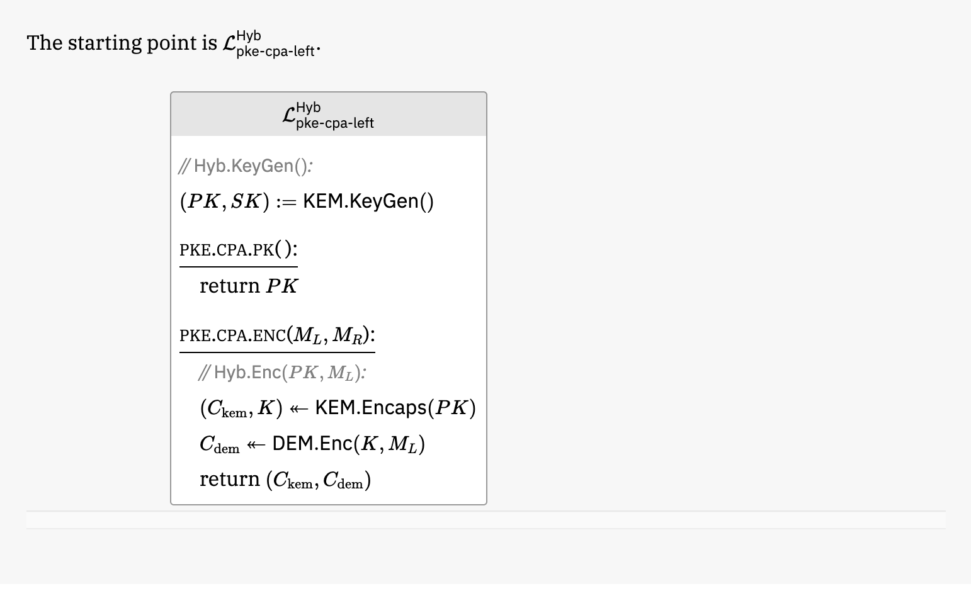
5. Proof: Game 0: Inline KEM-DEM scheme into CPA-left game

Slide 27
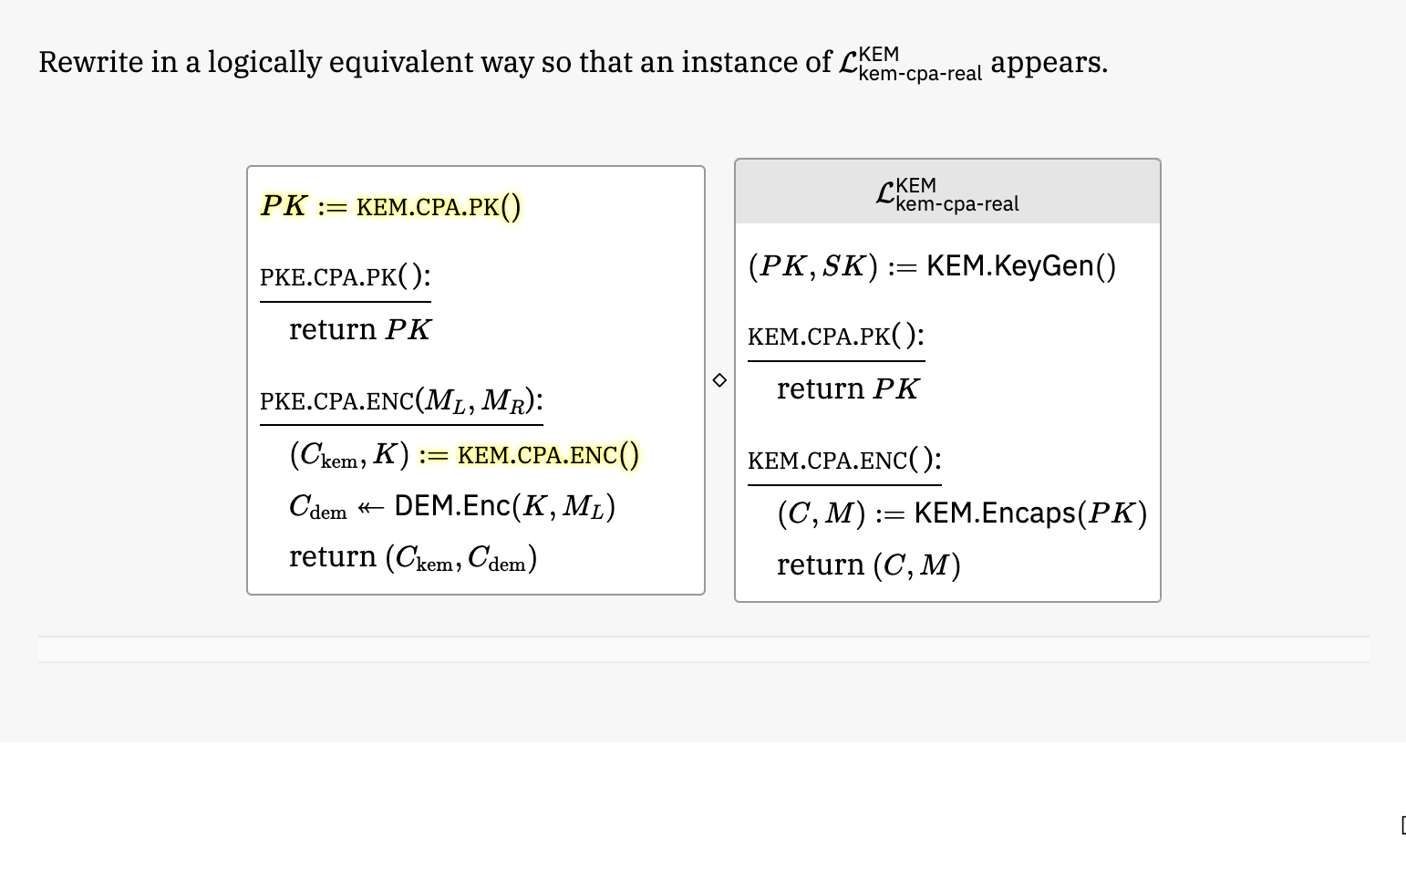
5. Proof: Game 0 is equivalent to a reduction calling into the CPA-real game for the KEM

Slide 28
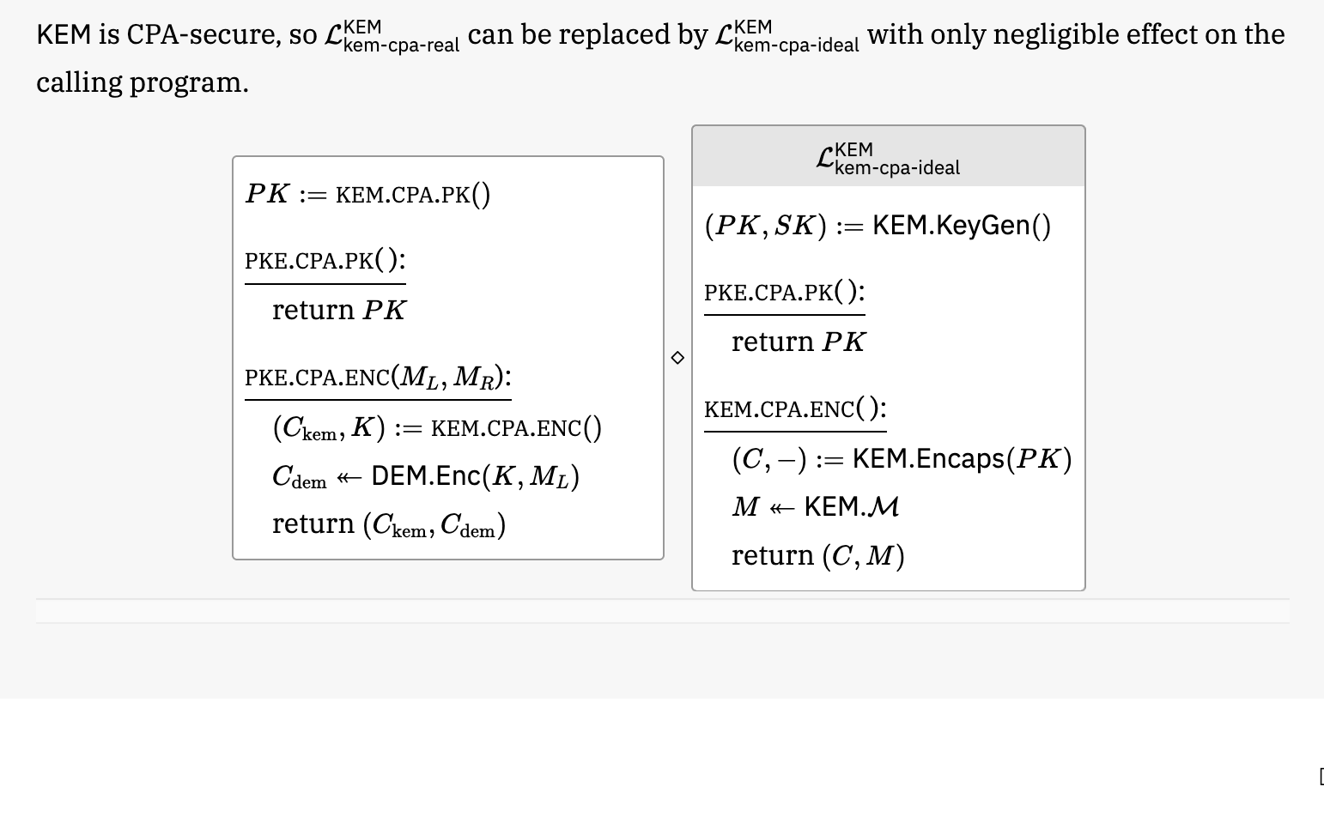
5. Proof: Hop to Game 1 by switching the KEM CPA-real game to CPA-ideal

Slide 29
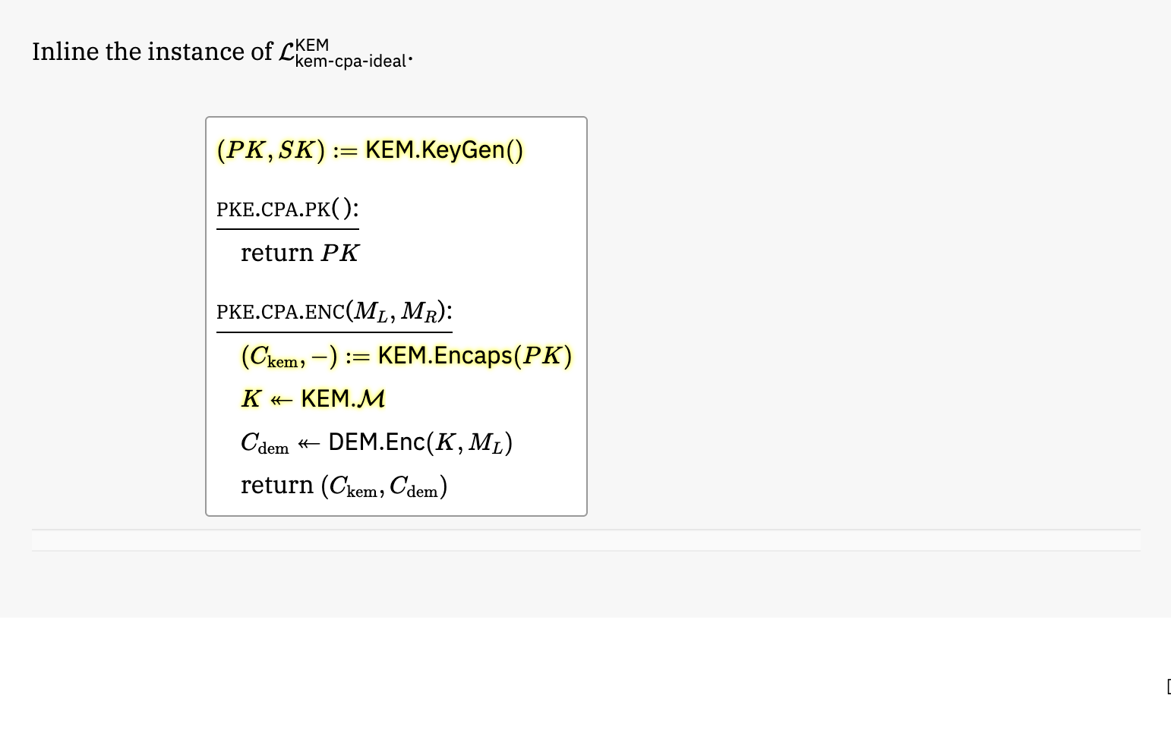
5. Proof: Game 1: Write out Game 1 explicitly by inlining previous slide

Slide 30
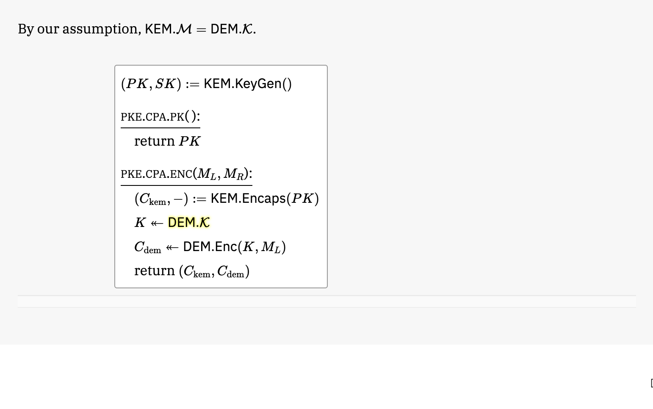
5. Proof: Game 1: Note that KEM shared secret space equals symmetric key encryption space

Slide 31
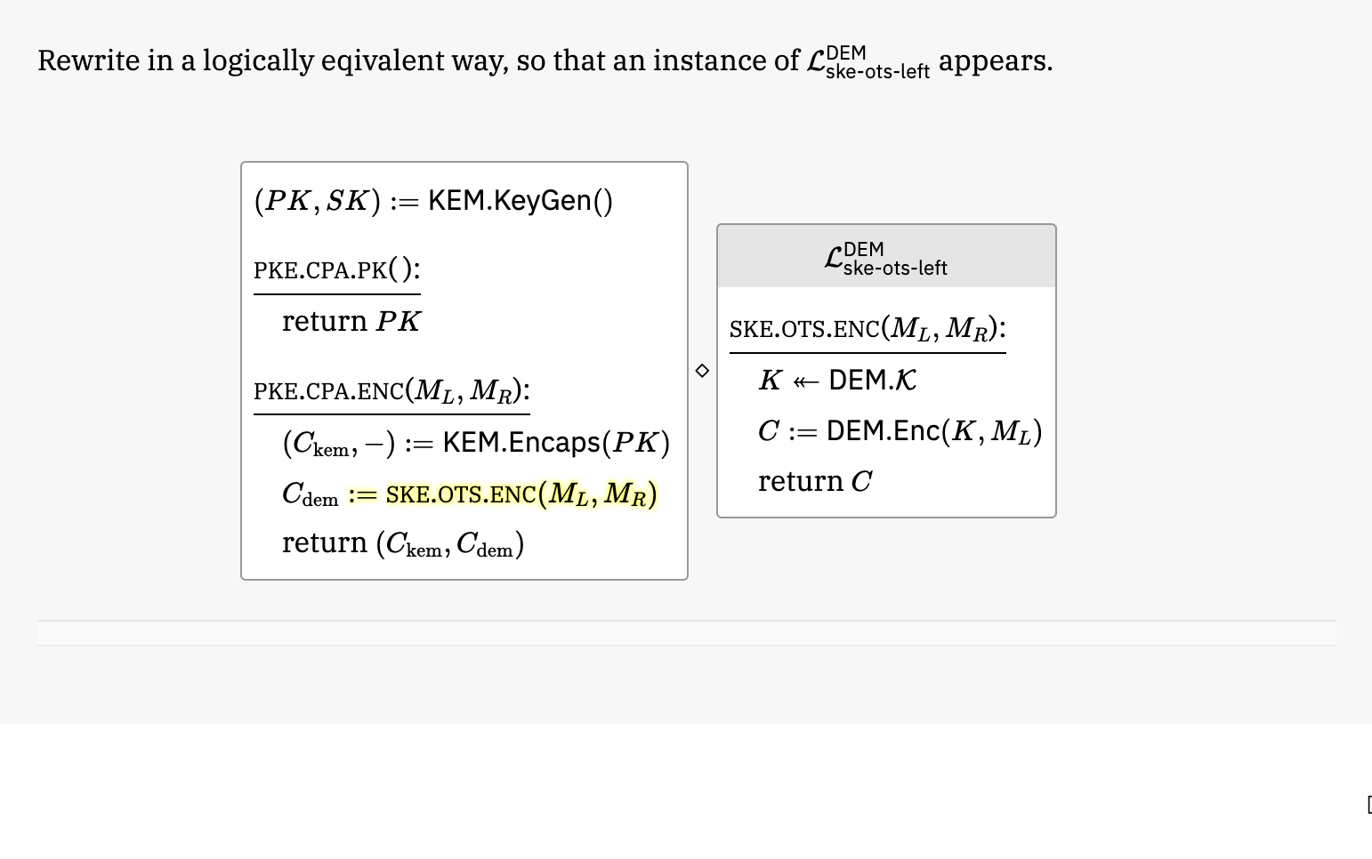
5. Proof: Game 1 is equivalent to a reduction calling into the OTS-left game for the DEM

Slide 32
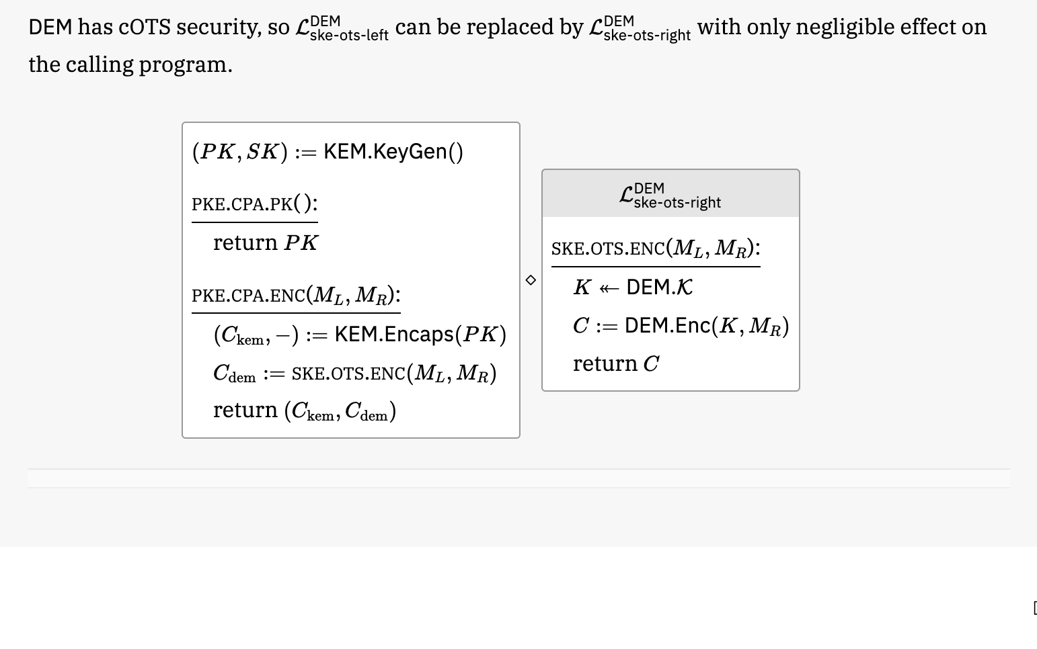
5. Proof: Hop to Game 2 by switching the DEM OTS-left game to OTS-right

Slide 33

5. Proof: Game 2: Write out Game 2 explicitly by inlining previous slide
Now we need to undo the use of a random encryption key

Slide 34
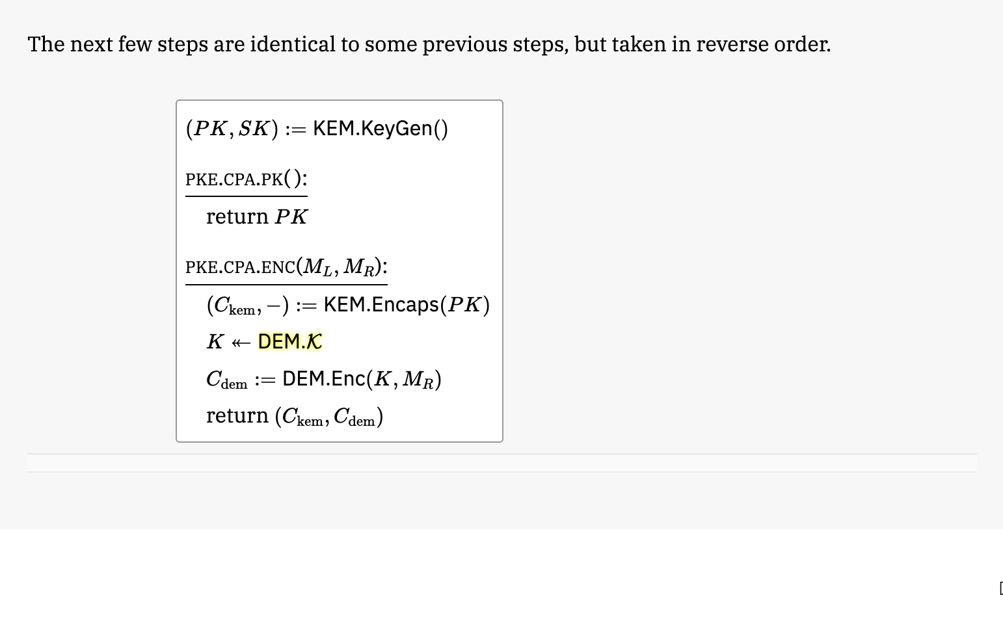
5. Proof: Game 2: Note that KEM shared secret space equals symmetric key encryption space

Slide 35
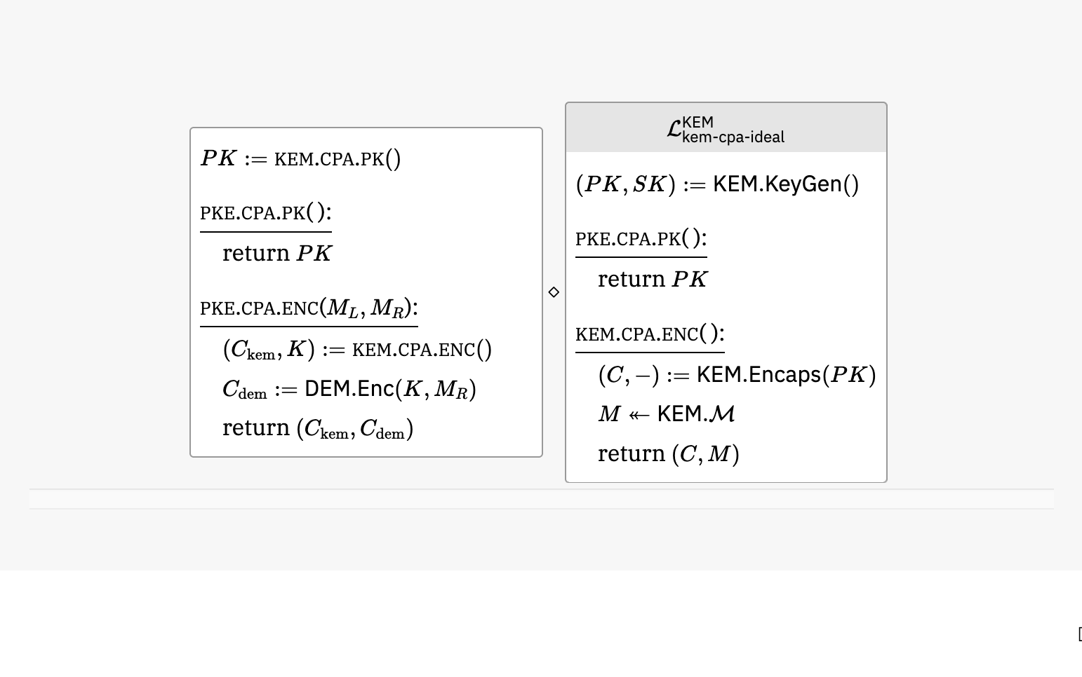
5. Proof: Game 2 is equivalent to a reduction calling into the CPA-ideal game for the KEM

Slide 36
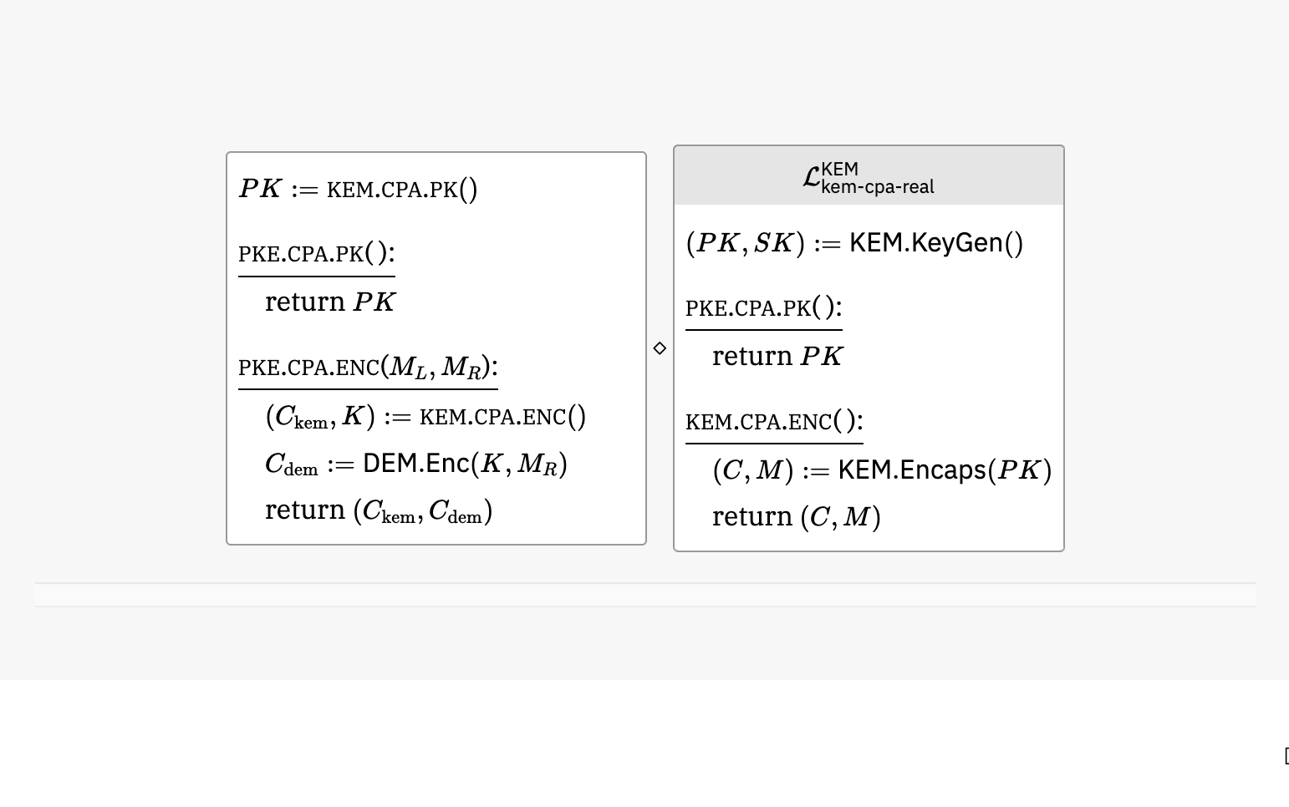
5. Proof: Hop to Game 3 by switching the KEM CPA-ideal game to CPA-real

Slide 37
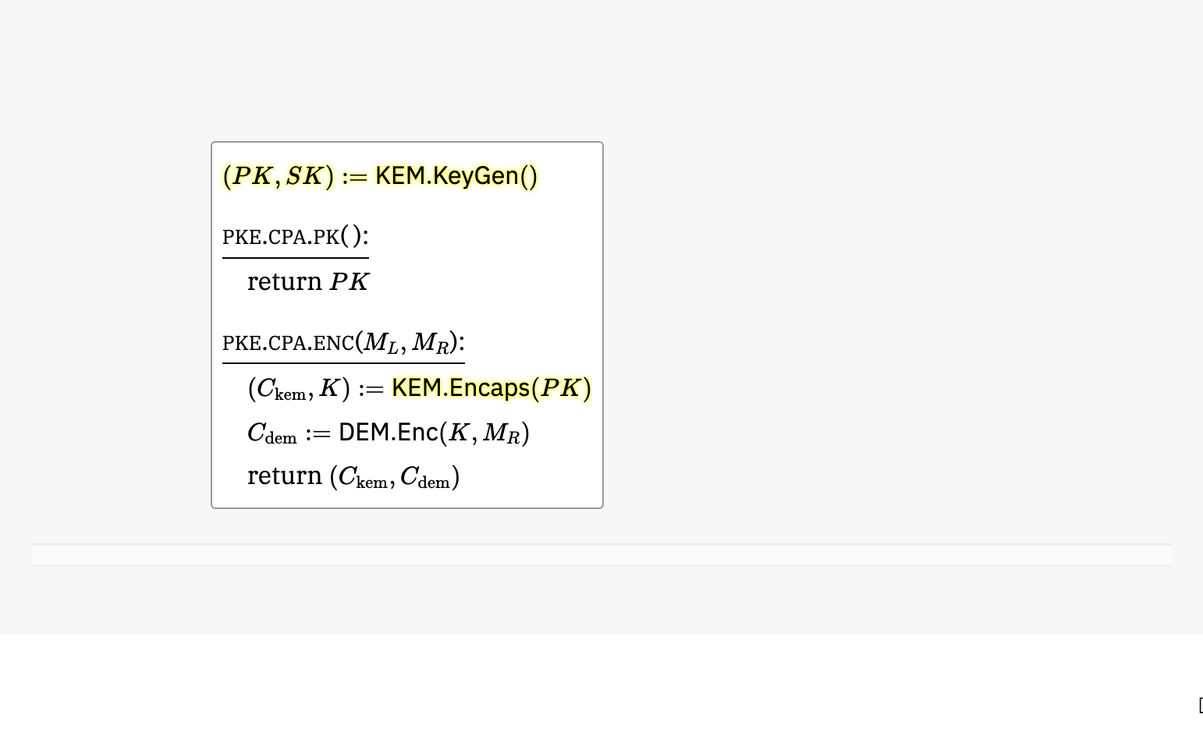
5. Proof: Game 3: Write out Game 3 explicitly by inlining previous slide

Slide 38
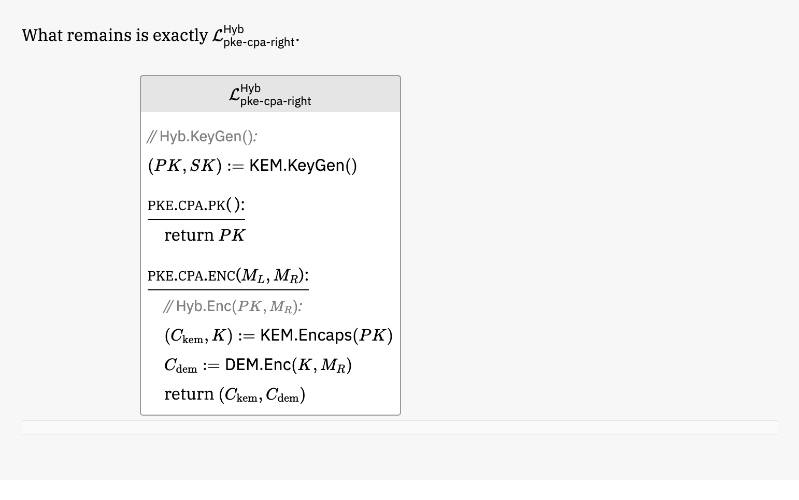
5. Proof: Game 3 is equivalent to the inlining of the KEM-DEM scheme into the PKE CPA-right game

Slide 39
5. Proof summary
Game 0: KEM-DEM scheme in PKE CPA-left game
Game 1: Use random KEM shared secret instead of real
Reduction R1 against KEM CPA security game
R1 with KEM-CPA-real = Game 0
R1 with KEM-CPA-ideal = Game 1
Game 2: Encrypt right message instead of left (under random key)
Reduction R2 against DEM OTS security game
R2 with DEM-OTS-left = Game 1
R2 with DEM-OTS-right = Game 2
Game 3: Use real KEM shared secret instead of random
Reduction R3 against KEM CPA security game
R3 with KEM-CPA-ideal = Game 2
R3 with KEM-CPA-real = Game 3
Game 3 = KEM-DEM scheme in PKE-CPA-right game

Slide 40
6. Theorem statement

Slide 41


ProofFrog: A Tool for Verifying Cryptographic Game-Hopping Proofs
https://prooffrog.github.io/
https://eprint.iacr.org/2025/418
Douglas Stebila
Joint work with Ross Evans and Matthew McKague
We acknowledge the support of the Natural Sciences and Engineering Research Council of Canada (NSERC).

Slide 42
ProofFrog
A new tool for representing and checking cryptographic game-hopping proofs in the computational model
Focus on accessibility & syntax for pen-and-paper cryptographers
Limited in scope, strength, expressivity, & more compared to other tools
Able to verify several Joy of Cryptography-style textbook examples
Not (yet) suitable for richer research-level proofs

Slide 43
ProofFrog's approach
The author of the proof states the reductions for each hop and optionally intermediate games.
ProofFrog tries to evaluate the validity of each game hop by checking code-wise equivalence of each step
Code-wide equivalence is checked by taking each game to be compared and applying a series of automated transformations to try to coerce the game into a "canonical form", and then comparing these canonical forms as strings
ProofFrog works with Abstract Syntax Trees
Examples of transformations: canonicalizing variable names, sorting sequence of statements, removing unused variables & statements, …
If ProofFrog's automated transformations manage to yield same canonical form: 😁
If ProofFrog's automated transformations don't suffice: out of luck

Slide 44
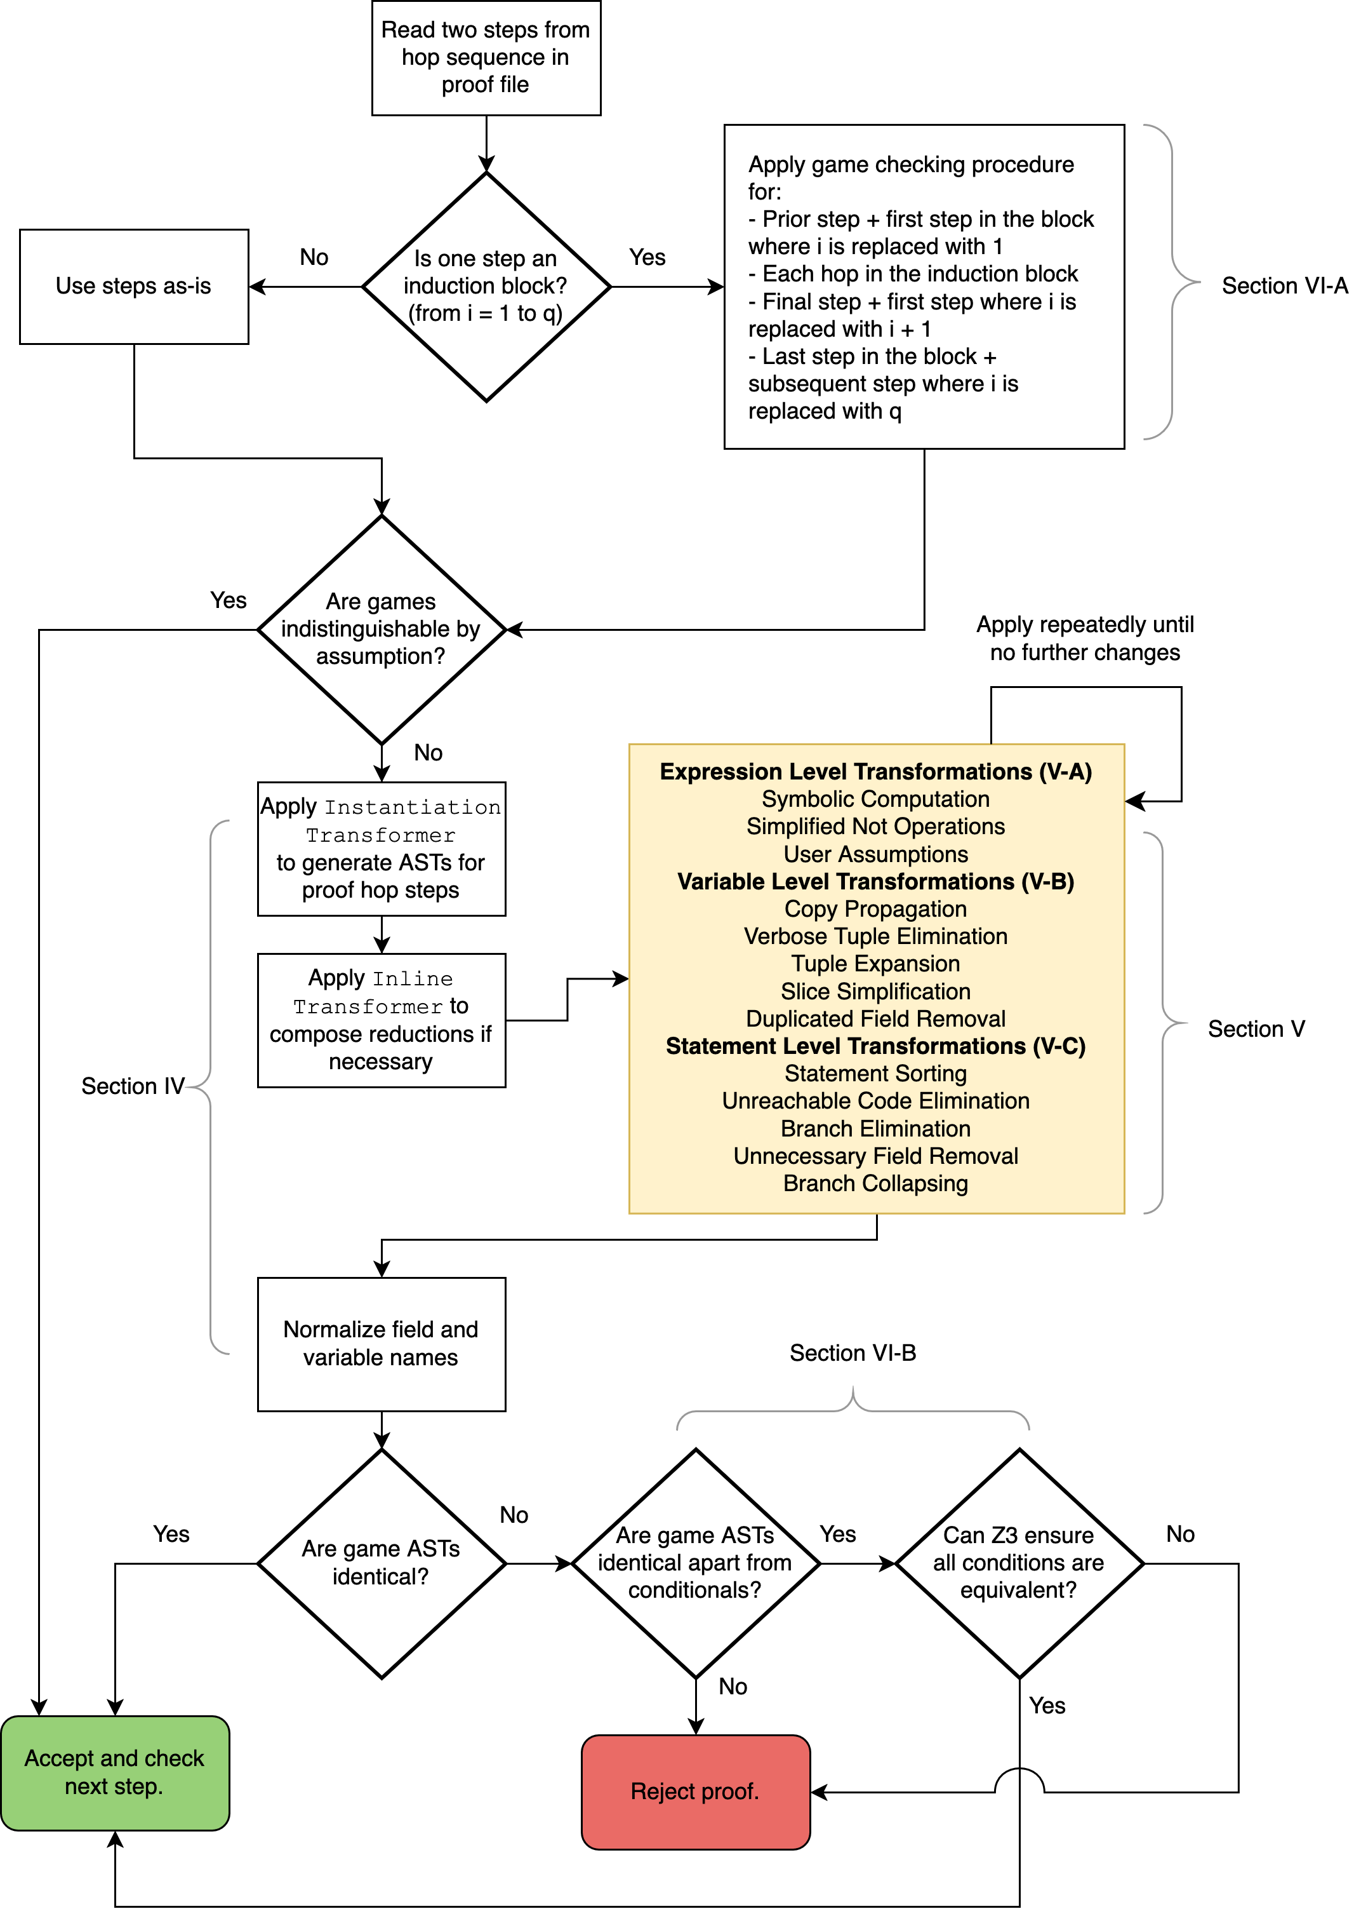
ProofFrog engine
See https://eprint.iacr.org/2025/418 for details

Slide 45
KEM-DEM is IND-CPA
in ProofFrog https://prooffrog.github.io/caps-2025.html

Slide 46
If we want to be thorough, we need to:
Symmetric encryption scheme: define (a) syntax; (b) one-time secrecy
Key encapsulation mechanism: define (a) syntax; (b) IND-CPA security
Public key encryption scheme: define (a) syntax; (b) IND-CPA security
State the KEM-DEM scheme
Give a game-hopping proof for IND-CPA security of KEM-DEM
State intermediate games (can be implicit)
Give reductions to security of KEM or DEM
Justify interchangeability / indistinguishability
State the theorem we just proved

Slide 47
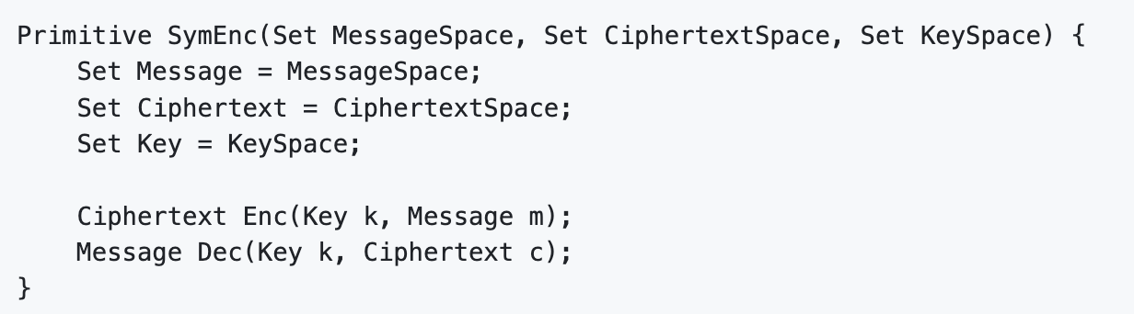
1.a) Syntax of symmetric encryption scheme
Definition is parameterized by some sets
Algorithm signatures

Slide 48
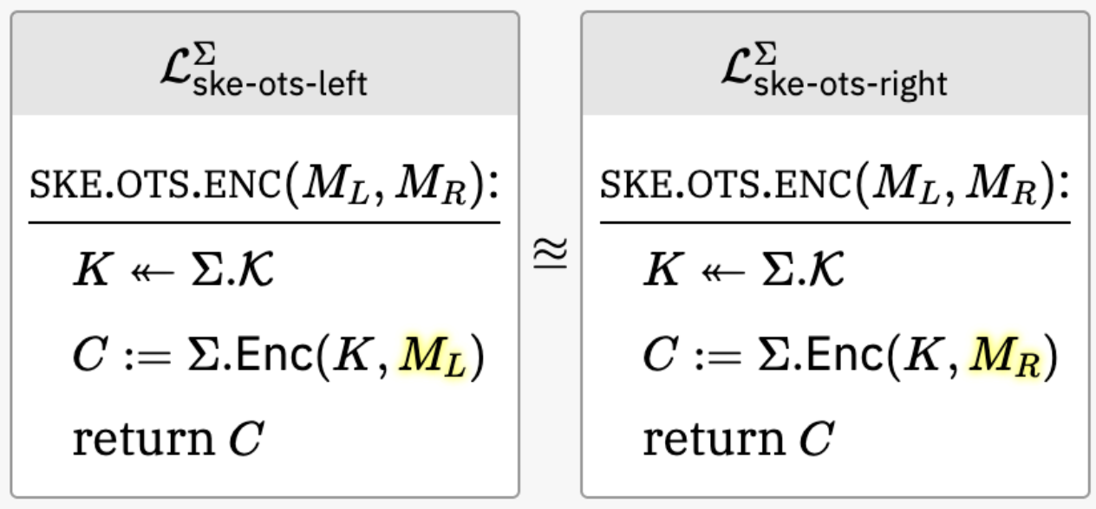
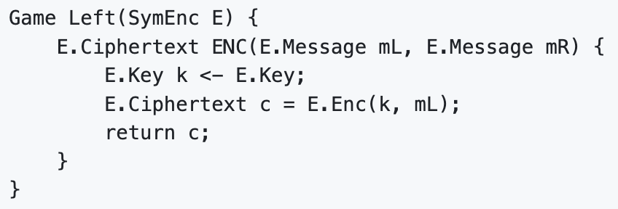
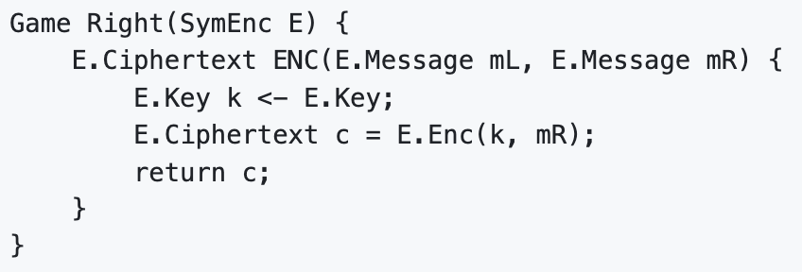
1.b) One-time secrecy of symmetric encryption
Observe that variables are typed

Slide 49
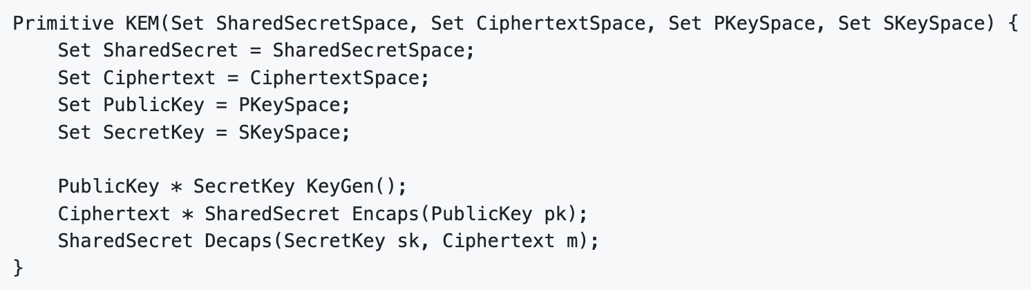
2.a) Syntax of key encapsulation mechanism
Definition is parameterized by some sets
Tuple
Algorithm signatures

Slide 50
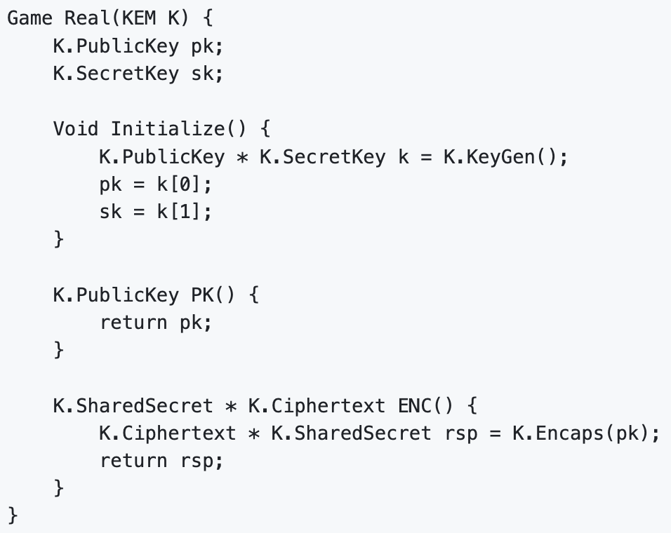
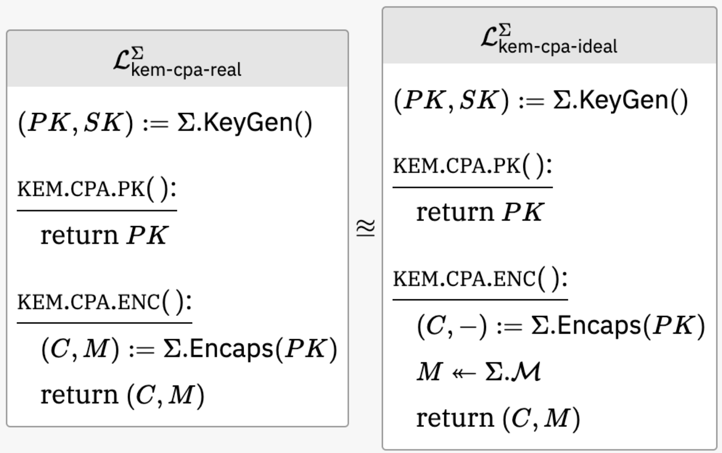
2.b) IND-CPA security of a KEM
Experiment private variables
Initialize
Adversary gets public key via oracle

Slide 51
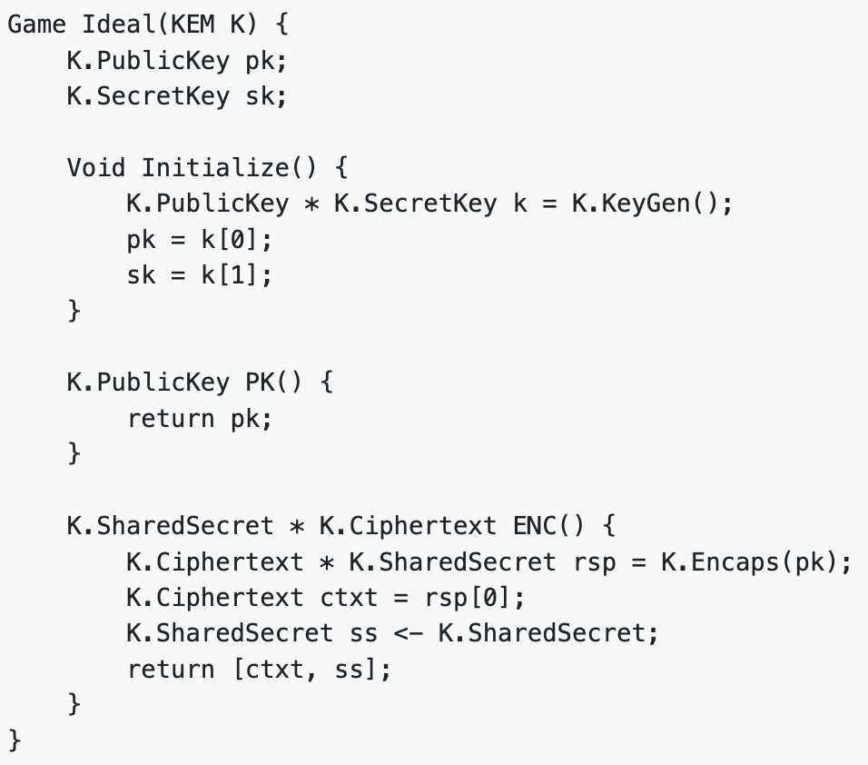
2.b) IND-CPA security of a KEM

Slide 52
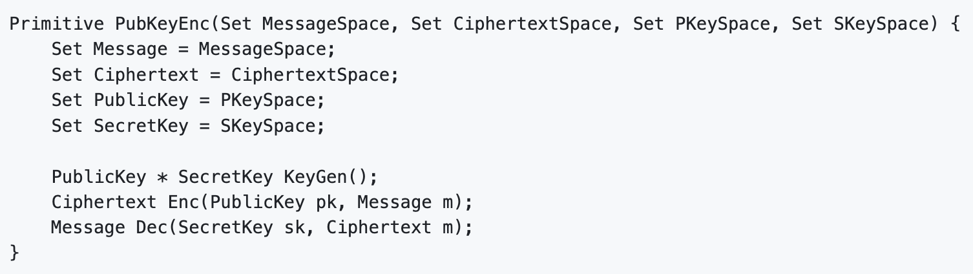
3.a) Syntax of public key encryption

Slide 53
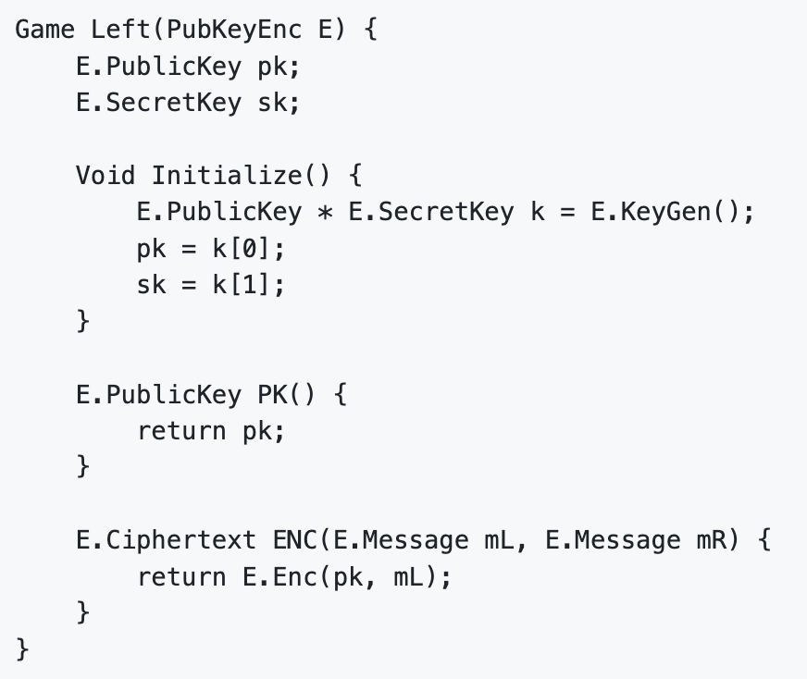
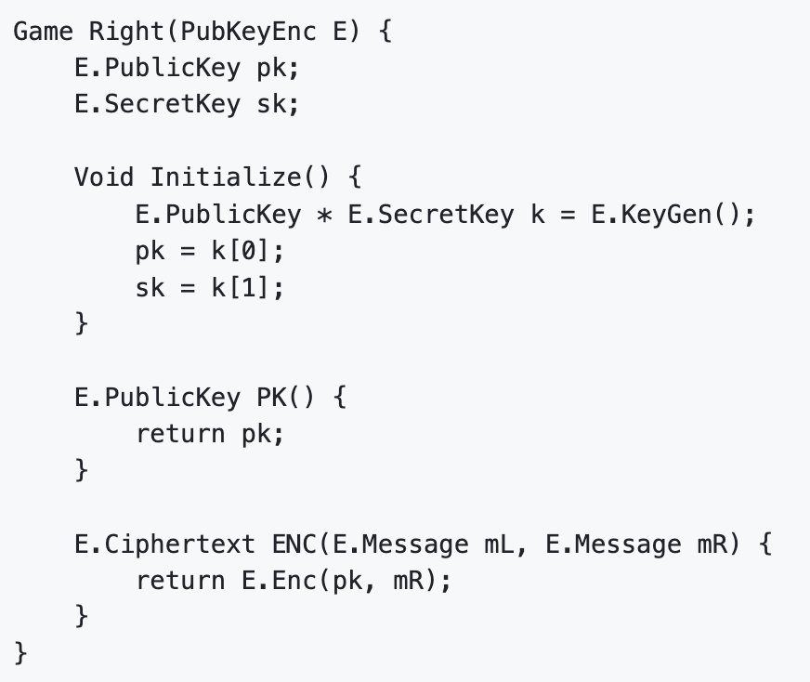
3.b) IND-CPA security of a PKE

Slide 54
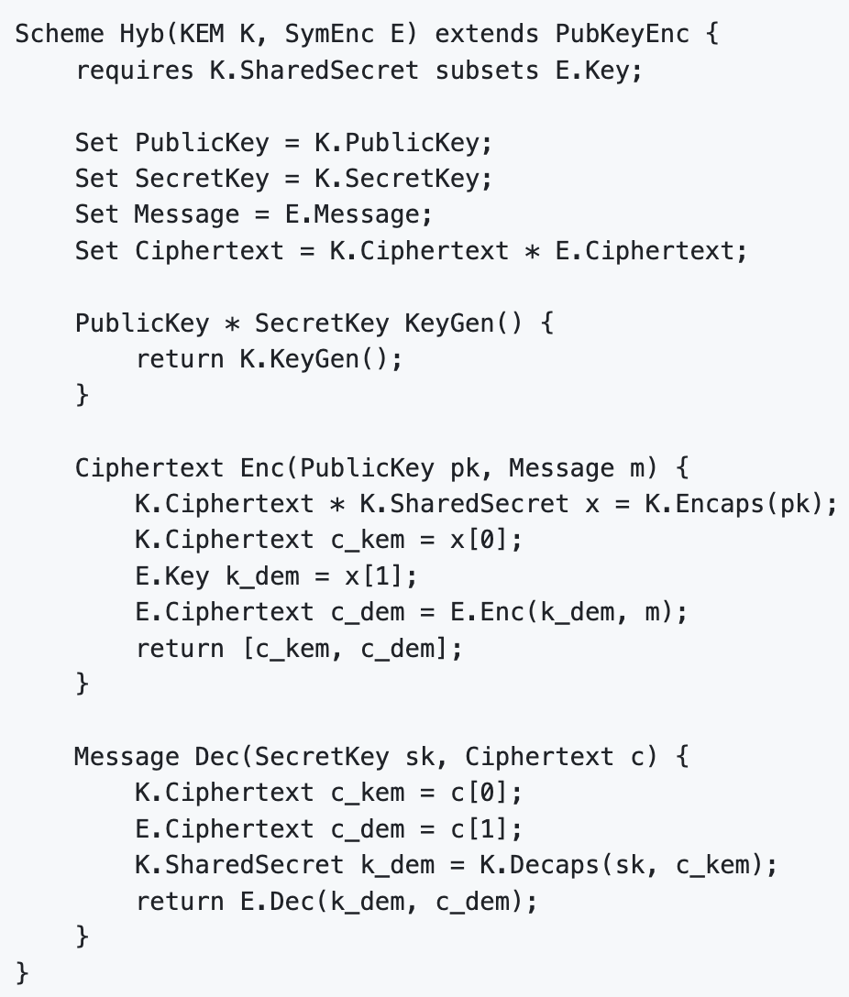
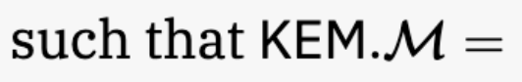
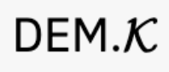
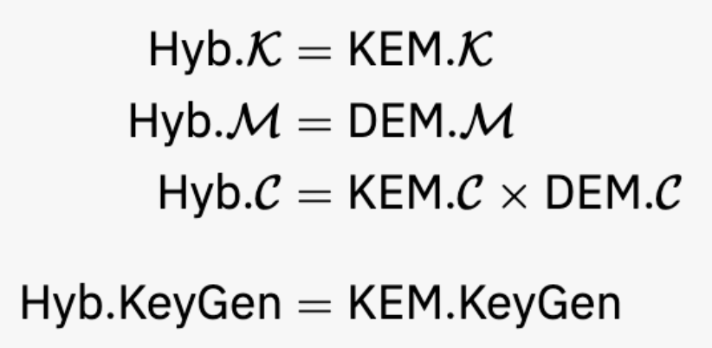
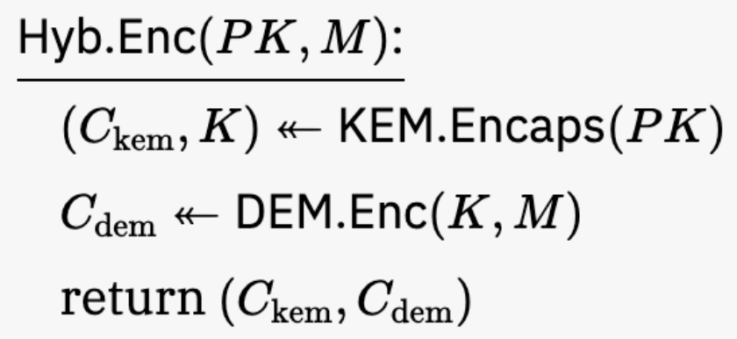
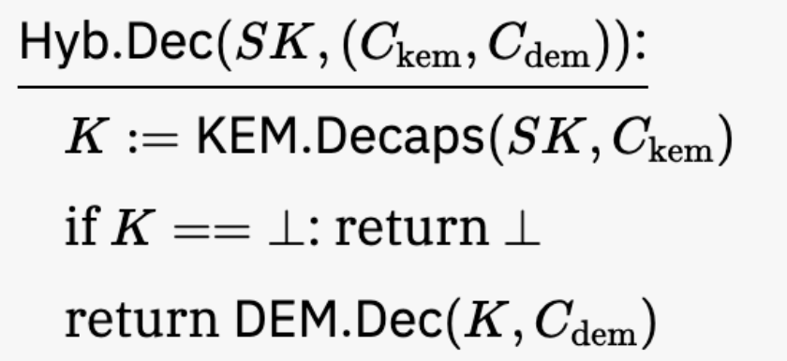
4. State the KEM-DEM scheme

Slide 55
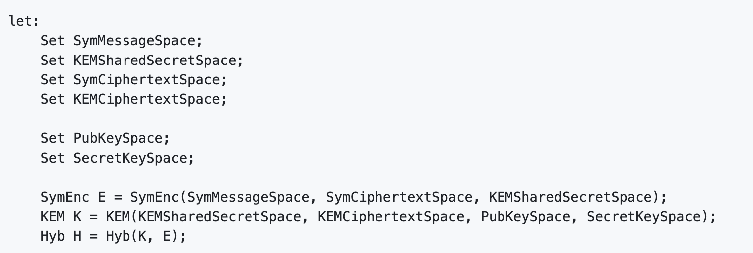
5. Proof: Setting up the theorem statement
First we list all the sets and primitives used in the theorem statement:
Sets
Primitives
Notice the DEM secret key space is equal to the KEM shared secret space
Target scheme

Slide 56
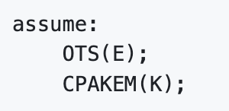
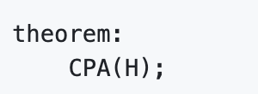
5. Proof: Theorem statement
Now we can state the security assumptions on the primitives:
And the goal of the theorem:

Slide 57
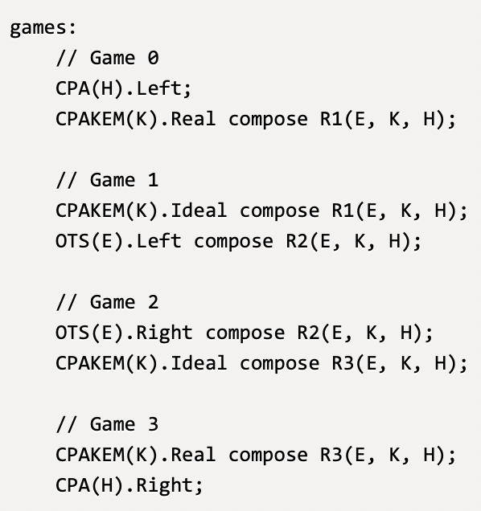
5. Proof summary
Game 0: KEM-DEM scheme in PKE CPA-left game
Game 1: Use random KEM shared secret instead of real
Reduction R1 against KEM CPA security game
R1 with KEM-CPA-real = Game 0
R1 with KEM-CPA-ideal = Game 1
Game 2: Encrypt right message instead of left (under random key)
Reduction R2 against DEM OTS security game
R2 with DEM-OTS-left = Game 1
R2 with DEM-OTS-right = Game 2
Game 3: Use real KEM shared secret instead of random
Reduction R3 against KEM CPA security game
R3 with KEM-CPA-ideal = Game 2
R3 with KEM-CPA-real = Game 3
Game 3 = KEM-DEM scheme in PKE-CPA-right game
* Minor simplification of ProofFrog notation: all game lines should have "against CPA(H).Adversary" at the end

Slide 58
5. Proof summary
Code-wise equivalence steps:
ProofFrog checks that these steps are code-wise equivalent by
inlining the scheme & reduction into the game
canonicalizing each game
comparing the programs as strings
* Minor simplification of ProofFrog notation: all game lines should have "against CPA(H).Adversary" at the end

Slide 59
5. Proof summary
Indistinguishable by assumption steps:
ProofFrog checks that these steps are indistinguishable by an assumption in the theorem statement:
assume: CPAKEM(K) implies CPAKEM(K).Real ≈ CPAKEM(K).Ideal
assume: OTS(E) implies OTS(E).Left ≈ OTS(E).Right
* Minor simplification of ProofFrog notation: all game lines should have "against CPA(H).Adversary" at the end

Slide 60
5. Proof summary
All that we have left to do is write out the three reductions R1, R2, R3
* Minor simplification of ProofFrog notation: all game lines should have "against CPA(H).Adversary" at the end

Slide 61
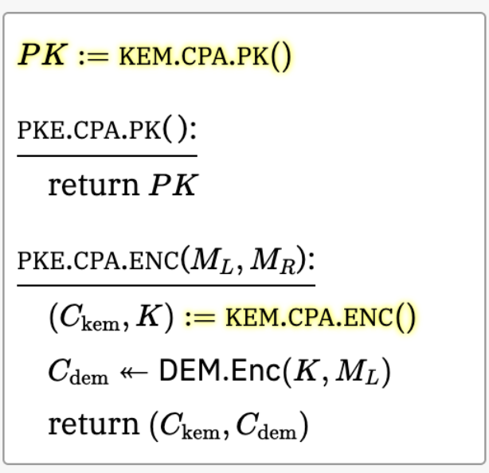
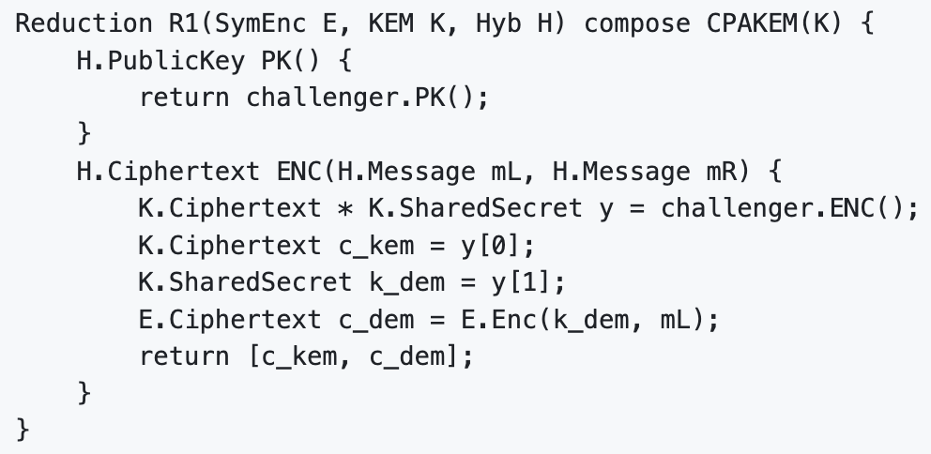
5. Proof: Reduction R1

Slide 62
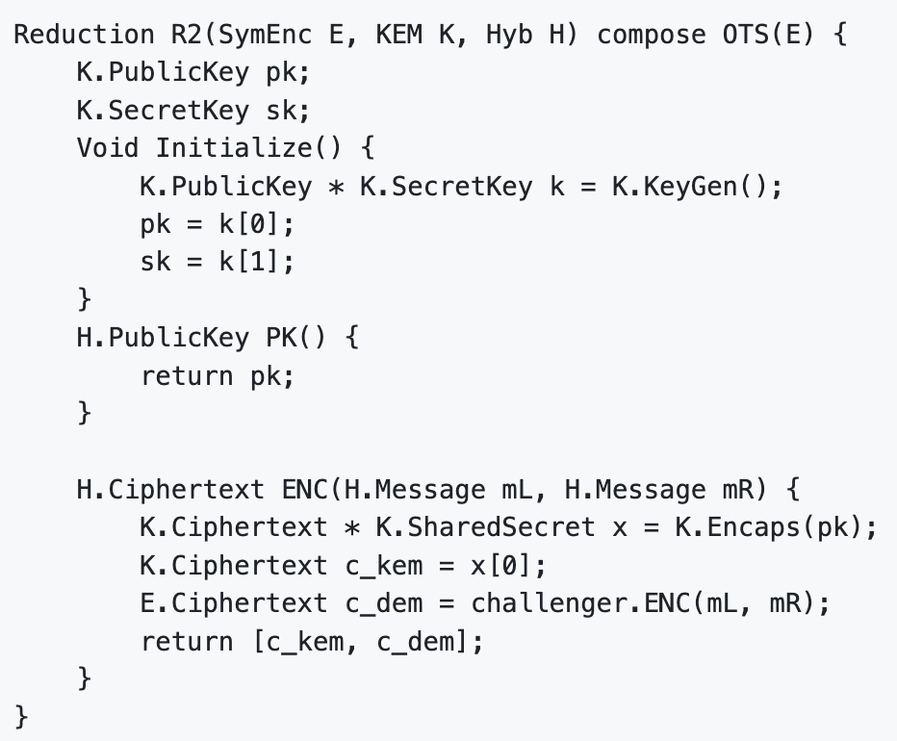
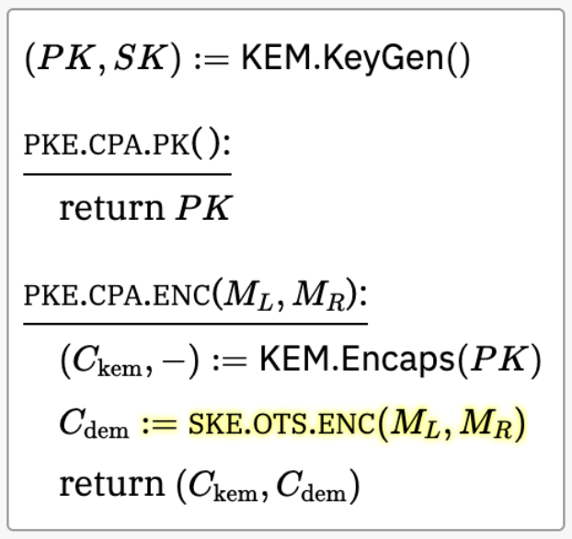
5. Proof: Reduction R2

Slide 63
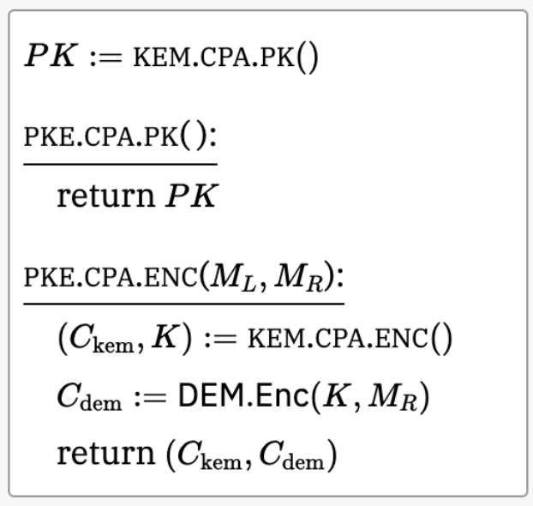
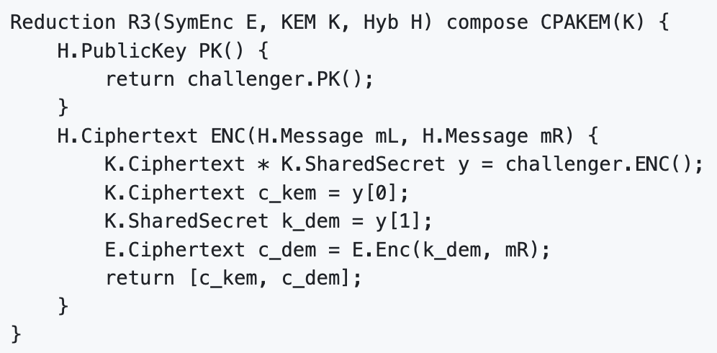
5. Proof: Reduction R3

Slide 64
We're done!
> proof_frog prove Hyb-is-CPA.proof
==STEP 1===
Current: CPA(H).Left;
Hop To: Game0(K, E, H);
SIMPLIFYING CURRENT GAME
Game Left() {
[…]
Inline Success!
Proof Succeeded!
3 files for primitive syntax: 27 LoC
3 files for security definitions: 83 LoC
1 file for scheme: 26 LoC
1 file for proof: 75 LoC
Took me about 30 minutes to write it

Slide 65
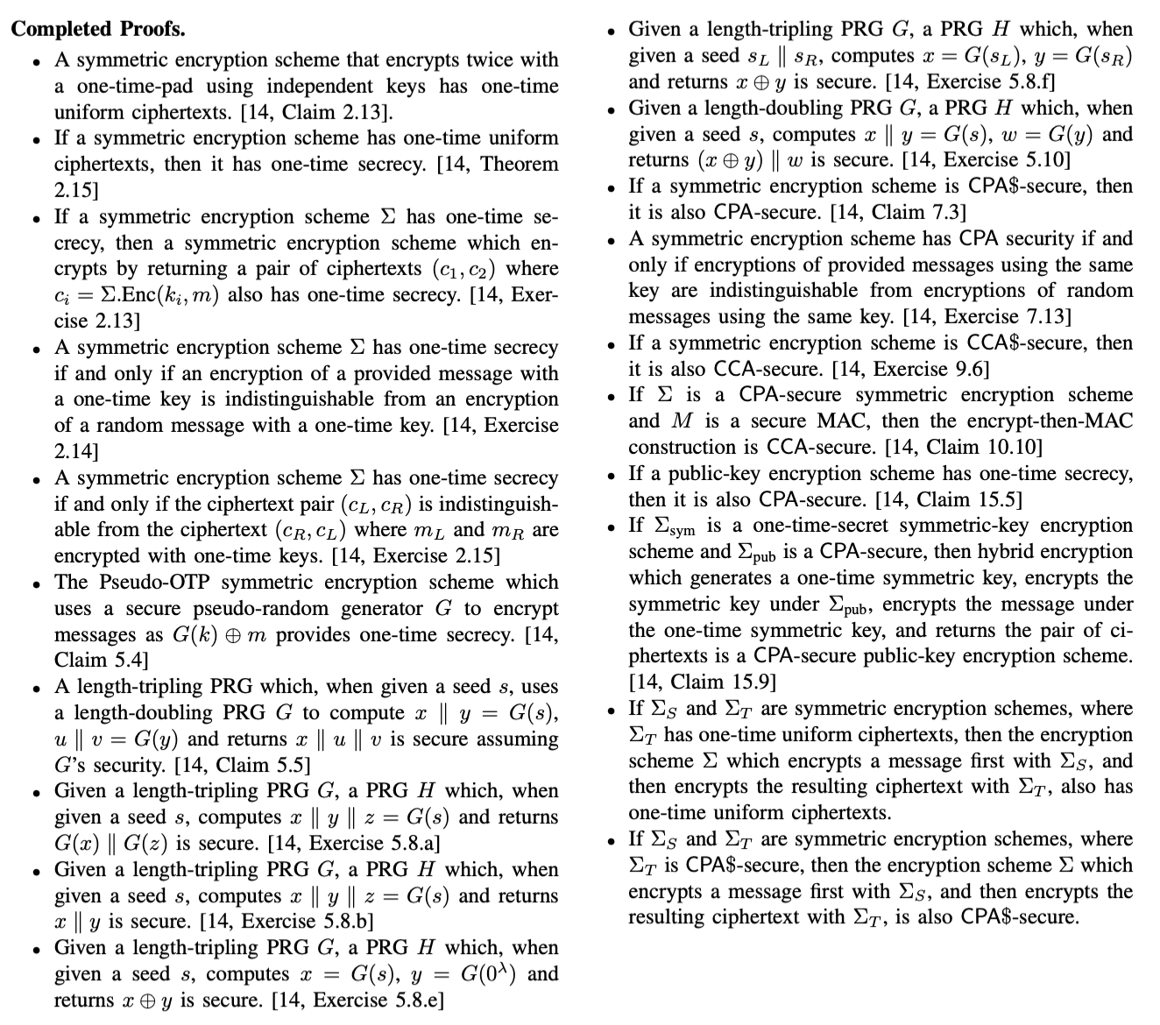
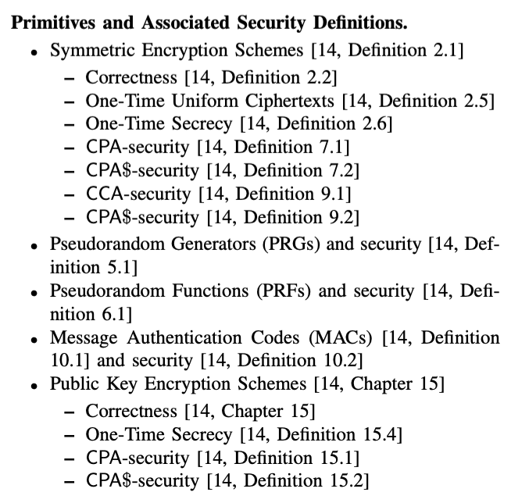
Other examples from Joy of Cryptography in ProofFrog

Slide 66
Neato: Variable-length hybrid argument in ProofFrog
games:
CPA(E).Left;
induction(i from 1 to q) {
OneTimeSecrecy(E).Left compose R(E, i);
OneTimeSecrecy(E).Right compose R(E, i);
}
CPA(E).Right;

Slide 67
ProofFrog has many limitations
No formal-verified base or precise semantics
Very tied to the game-hopping formalism
Restricted domain specific language
Very little understanding of mathematics
No manual intervention if proof engine fails
No attempt yet at protocols with complex states
Minimal tooling and documentation
Minimal developer community

Slide 68
Q: What is the future of ProofFrog?
A: Uncertain; looking for feedback

Slide 69
Continue developing ProofFrog as a formal verification engine?
Transition to a tool to support pen-and-paper cryptographers?
Improve expressivity
Option to fork out to EasyCrypt when stuck
Export to LaTeX
Manage game source code for pen-and-paper proofs in a domai—specific language
Some type-checking and minimal validation
Export to LaTeX

Slide 70
Want to get started with ProofFrog?
Easy to install with Python (pip3 install proof_frog)
Engine and examples at https://github.com/ProofFrog/
(Hopefully) fun way to write your first formally verified proof!
Be aware of limitations
Ask questions on Github Discussions
Contact me (dstebila@uwaterloo.ca) if you have thoughts on the possible directions (formal verification engine? pen-and-paper support tool?) and want to help out

Slide 71

ProofFrog: A Tool for Verifying Cryptographic Game-Hopping Proofs
https://prooffrog.github.io/
https://eprint.iacr.org/2025/418
Douglas Stebila
Joint work with Ross Evans and Matthew McKague
We acknowledge the support of the Natural Sciences and Engineering Research Council of Canada (NSERC).

